Slide 1
Characteristics of Health Insurance and Access to Care across the United States and Minnesota
Elsa Carlson, Kylee LaPierre, Tarick Mehanna, and Logan Sell

Slide 2
Introduction and Initial Questions

Slide 3
Introduction
Primary objective: identify trends and patterns of health insurance coverage so that resources can be best allocated to areas or groups where coverage is less common/accessible
Definitions for our analysis:
Sufficient access to care: those who do not delay or avoid seeking healthcare services due to cost or location.
Uninsured: people who don’t have any type of health insurance.
2019 is the primary year for our data
To interpret data from immediately pre-pandemic
Our model used data from 2015 to 2019
Notes:
Executive summary
2019: a lot of data sources had more data for 2019 AND it’s pre-pandemic (things changed during pandemic)

Slide 4
Initial Questions
How do uninsurance rates vary among demographics such as race, age, sex, population, income, and educational attainment level?
How does access to healthcare vary at a national level and by county?
How does access to healthcare vary among Minnesota counties?
Do rates of uninsurance vary based on offered coverage types?
Does the rate of uninsurance vary for individuals based on the number of hospitals in their county?
Can we predict the coverage level for a county based on demographics, income or other factors?
For those who are covered, is their coverage sufficient for their health needs?

Slide 5
Research Process

Slide 6
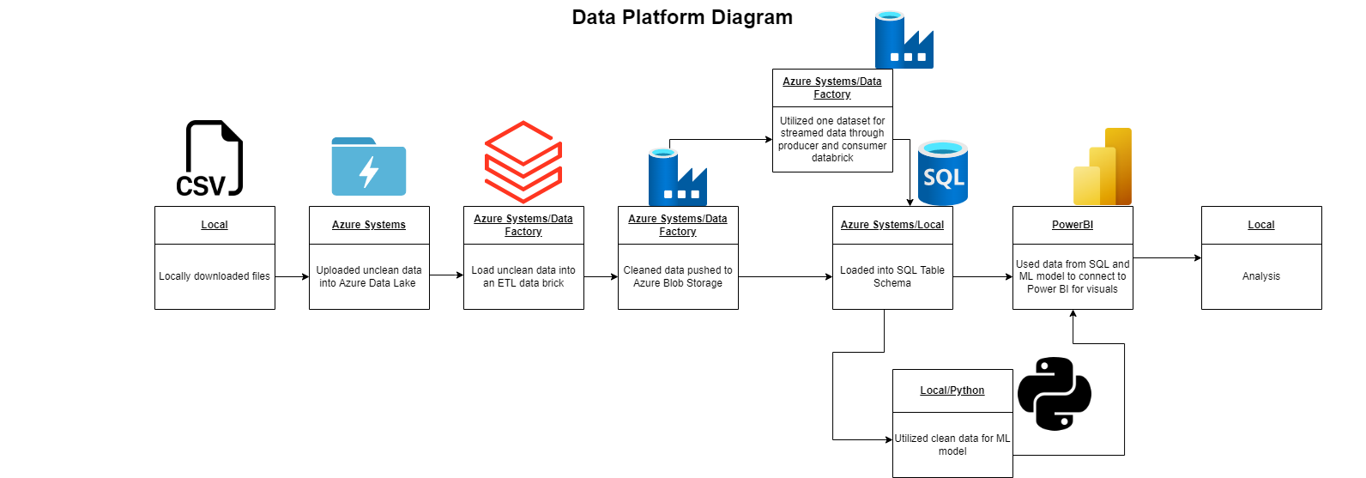
Finding & Processing Data
Used data mainly from the US Census Bureau and the CDC
Behavioral Risk Factor Surveillance System (BRFSS)
Data process: extraction → cleaning & transformation → loading to SQL database
Notes:
Used Azure databricks, azure blob storage, azure data factory, python, SQL, powerbi, and we linked our ML Model from Python to our PowerBI report to make some visualizations.

Slide 7
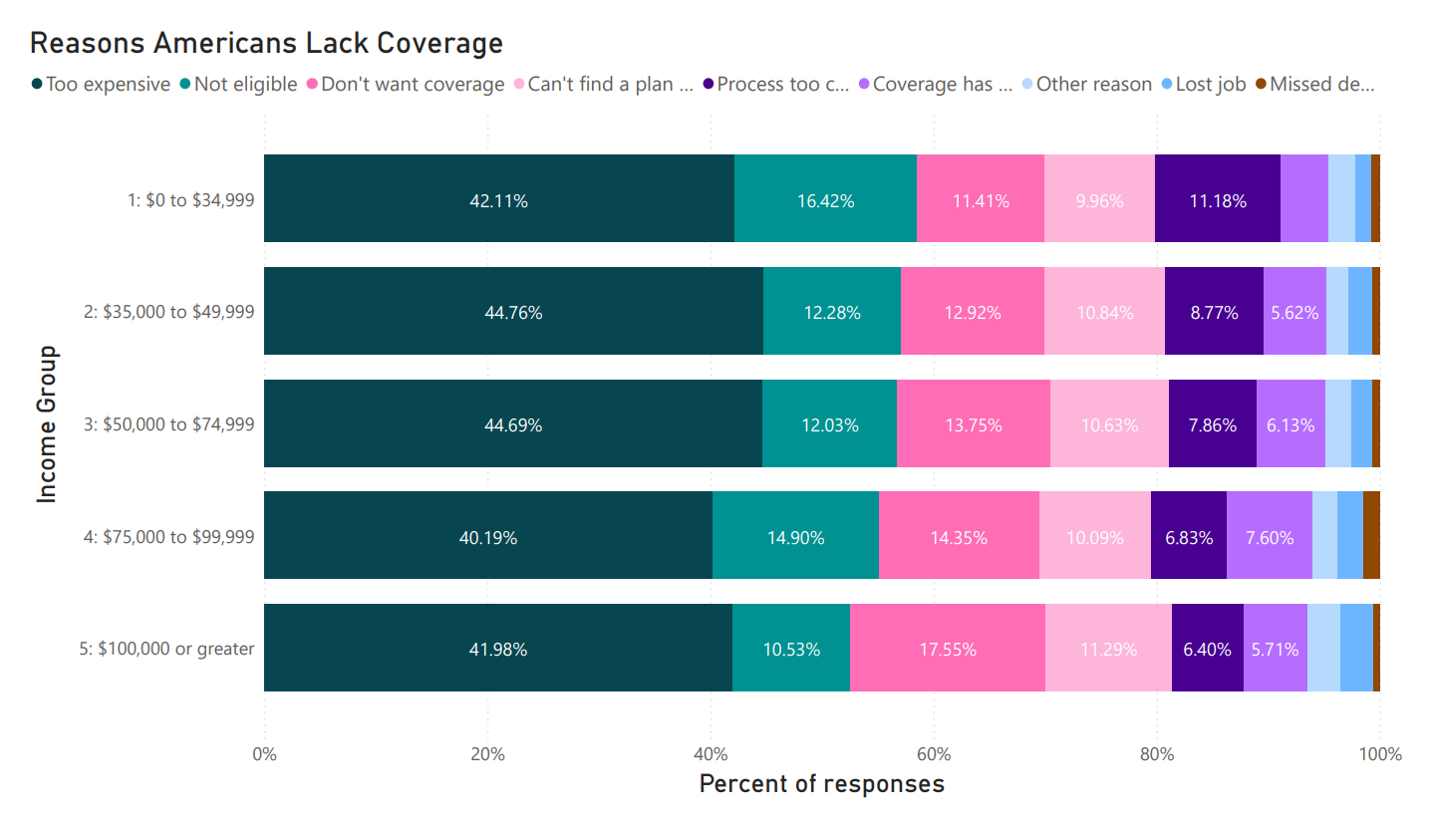
Analyzing Data - National
Notes:
Visual 1:
Visual 2: Survey respondents could choose multiple reasons for lacking coverage
Visual 3:

Slide 8
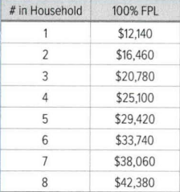
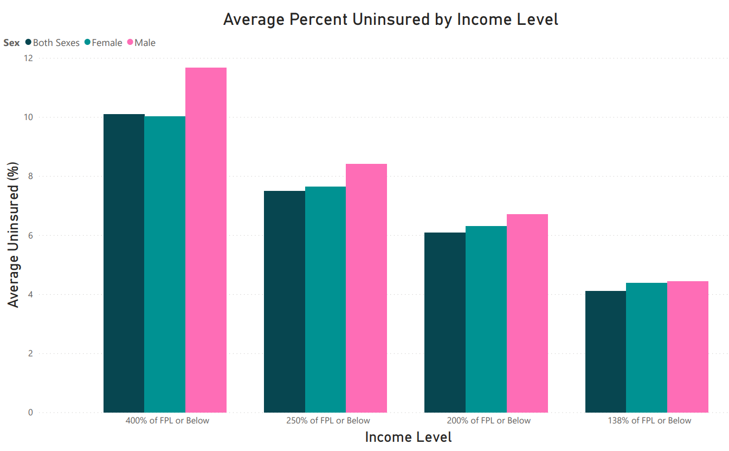

Slide 9
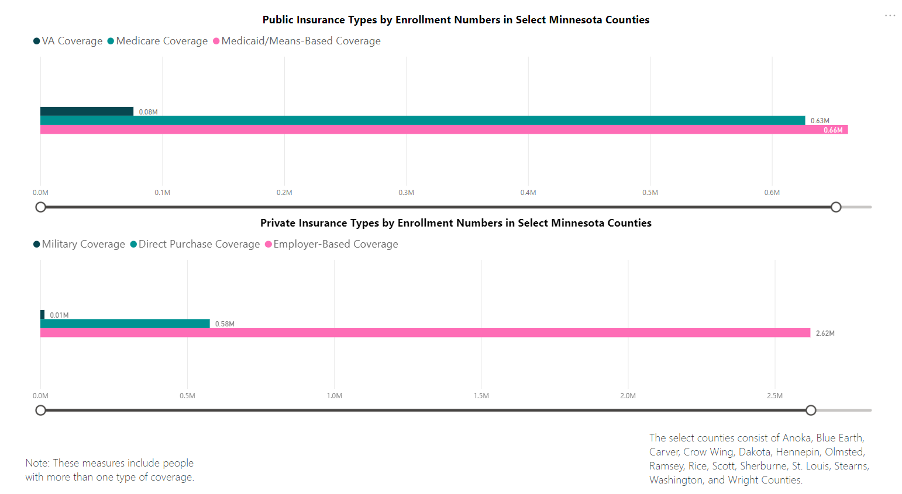
Analyzing Data - Minnesota
Notes:
Visual 1: Employer-based insurance is higher than all other categories combined. The select counties contain MN’s most populous communities.
Visual 2: No data available for $15,000-$25,000 income level in MN (cost prevented from seeking care visualization)
Visual 3: Highest in Nobles County, lots of lower rates clustered in Mpls/St. Paul.

Slide 10
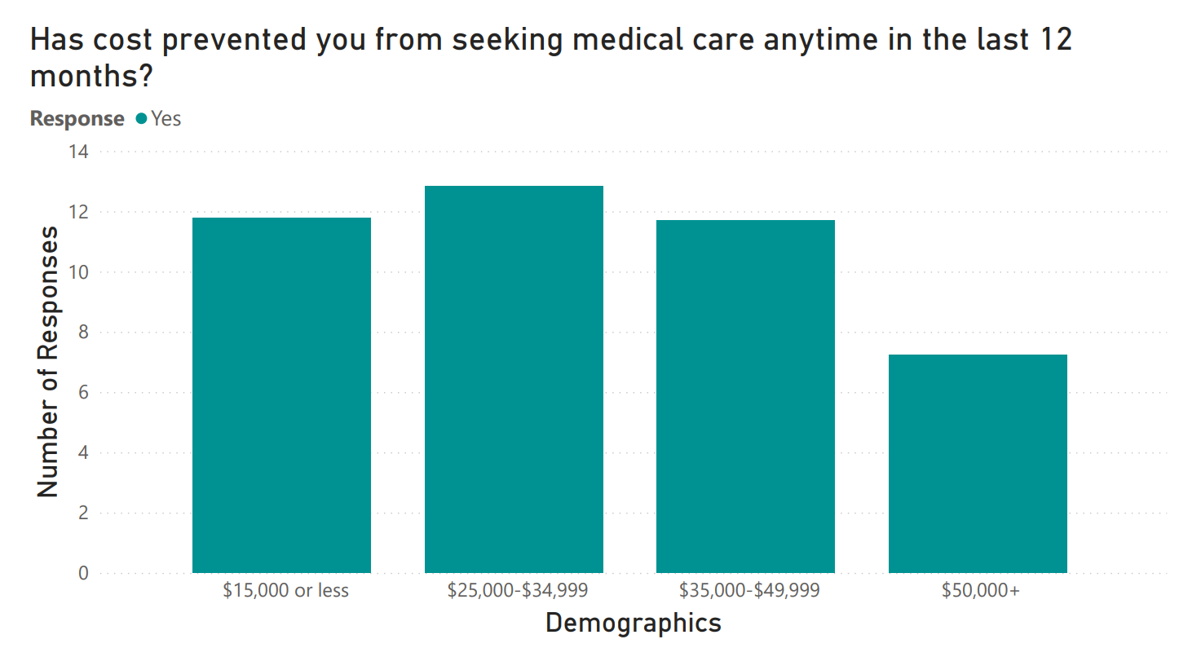

Slide 11
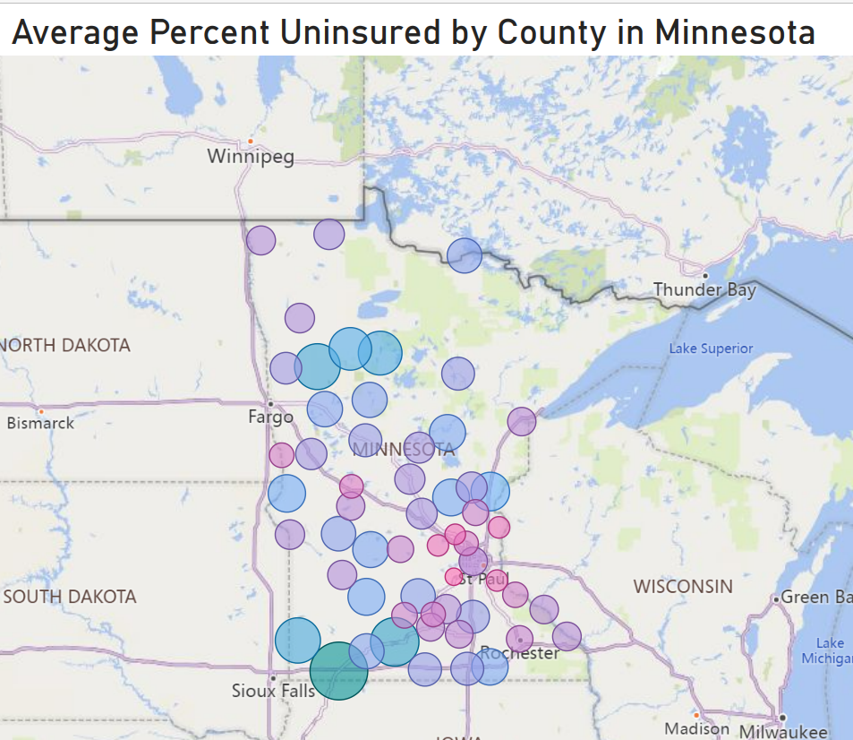
Nobles Co. (7.85%)

Slide 12
Machine Learning

Slide 13
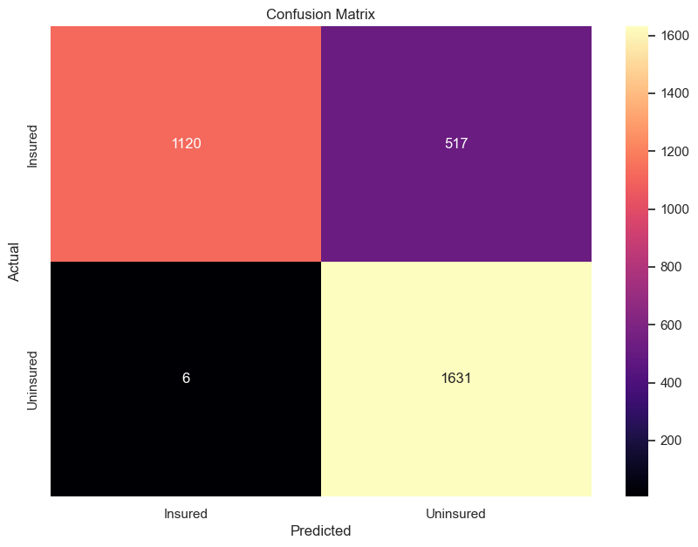

Slide 14
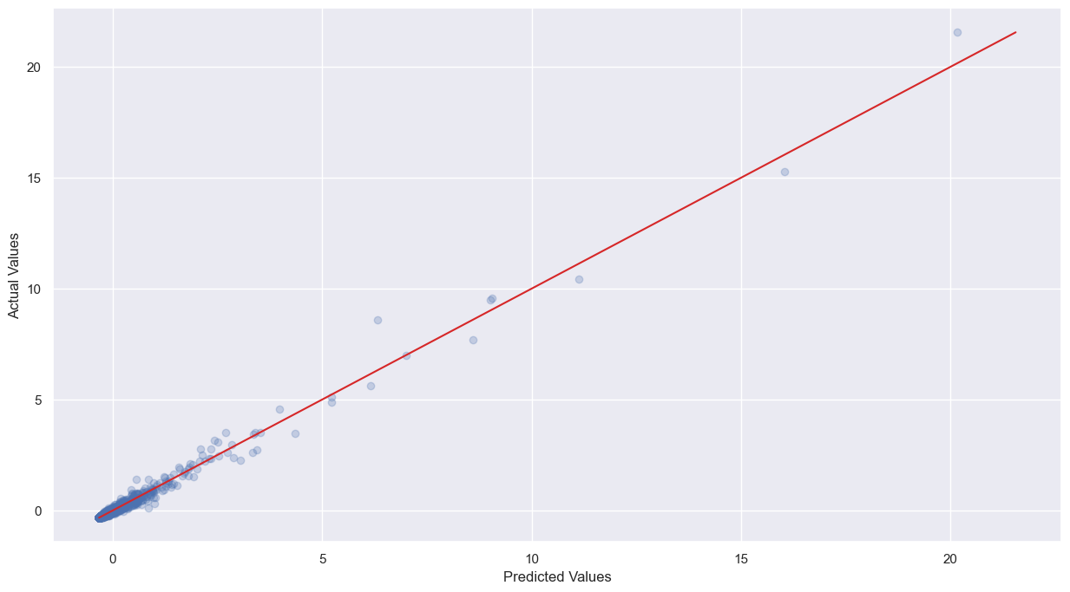

Slide 15
Recommendations

Slide 16
Recommendations for Future Data Collection & Research
Increase data collection in rural and lower-population counties
Track reasons for lacking insurance by demographics other than income level
Study intersection of demographics in relation to avoidance of medical care & access to coverage (including location, race/ethnicity, income, etc)
Classify public insurance enrollees who work full-time by whether or not their employers offer employer-based insurance
Track tobacco usage in relation to insurance affordability
Investigate strategies to increase insurance affordability
Notes:
We would like to see an increase in the data collection in lower-populated areas across the country as they only have the metro areas.
We also would like to see that reasons for lacking insurance by demographics other than income level,

Slide 17
Sources
Bureau, U. S. C. (2019). CB1900CBP: All Sectors: County Business Patterns by Legal Form of Organization and Employment Size Class for U.S., States, and Selected Geographies: 2019. Explore census data. Retrieved September 21, 2022, from https://data.census.gov/cedsci/table?q=hospital+cb&g=0100000US%240400000_0400000US27&tid=CBP2019.CB1900CBP
Bureau, U. S. C. (2019). DP05: ACS Demographic and Housing Estimates. Explore census data. Retrieved September 21, 2022, from https://data.census.gov/cedsci/table?q=DP05&g=0100000US%240400000&tid=ACSDP1Y2019.DP05
Bureau, U. S. C. (2019). S2701: Selected Characteristics of Health Insurance Coverage in the United States. Explore census data. Retrieved September 21, 2022, from https://data.census.gov/cedsci/table?q=health+insurance&g=0100000US%240500000_0400000US27&tid=ACSST1Y2019.S2701&moe=false
Bureau, U. S. C. (2019). S2703: Private Health Insurance Coverage by Type and Selected Characteristics. Explore census data. Retrieved September 21, 2022, from https://data.census.gov/cedsci/table?q=health+insurance&g=0400000US27%2C27%240500000&tid=ACSST1Y2019.S2703
Bureau, U. S. C. (2019). S2704: Public Health Insurance Coverage by Type and Selected Characteristics. Explore census data. Retrieved September 21, 2022, from https://data.census.gov/cedsci/table?q=health+insurance&g=0400000US27%2C27%240500000&tid=ACSST1Y2019.S2704

Slide 18
Sources
Bureau, U. S. C. (2022, August 10). 2008 - 2020 small area health insurance estimates (SAHIE) using the American Community Survey (ACS). Census.gov. Retrieved September 21, 2022, from https://www.census.gov/data/datasets/time-series/demo/sahie/estimates-acs.html Only used the year 2019 from this website.
CDC. (2021, April 5). NHIS - 2019 NHIS. Centers for Disease Control and Prevention. Retrieved September 21, 2022, from https://www.cdc.gov/nchs/nhis/2019nhis.htm
CDC. (2021, December 16). Behavioral risk factors: Selected metropolitan area risk trends (SMART) MMSA prevalence data (2011 to present). Centers for Disease Control and Prevention. Retrieved September 21, 2022, from https://chronicdata.cdc.gov/Behavioral-Risk-Factors/Behavioral-Risk-Factors-Selected-Metropolitan-Area/j32a-sa6u?category=Behavioral-Risk-Factors&view_name=Behavioral-Risk-Factors-Selected-Metropolitan-Area
CDC. (2021, September 14). BRFSS: Table of health care access/coverage. Centers for Disease Control and Prevention. Retrieved September 21, 2022, from https://chronicdata.cdc.gov/Behavioral-Risk-Factors/BRFSS-Table-of-Health-Care-Access-Coverage/f7a2-7inb
Prescott, R. (2016, June 22). USA-cities-and-states/US_CITIES_STATES_COUNTIES.CSV at master · Grammakov/USA-Cities-and-States. GitHub. Retrieved September 26, 2022, from https://github.com/grammakov/USA-cities-and-states/blob/master/us_cities_states_counties.csv

